Slide 1
The Battle of Neighbourhoods
Applied Data Science Capstone project(IBM)

Slide 2
Contents
Introduction (Business Problem)
Data
Procedure
Analysis
Result and Discussion
Inference

Slide 3
1. Introduction (business problem)
According the latest NYC&Company release New York City welcomed about 65.2 million tourists in 2018 year - 51.6 million domestic and 13.5 million international visitors. And these numbers are continuously increasing from year to year -
The data set-https://en.wikipedia.org/wiki/Tourism_in_New_York_City
New York City has the largest selection of lodging choices in the country – from the hostels to the luxury hotels. The prices vary from 100$ till several thousand dollars with average price 292 USD per night.
The Hotel Occupancy rate is also high – in 2018 year it was 88% as seen by the data set given in the below link https://assets.simpleviewinc.com/simpleview/image/upload/v1/clients/newyorkcity/FYI_Hotel_reports_February_2019_8607015b-b32a-4c7f-9fbd-84cd2a93cbe6.pdf
Visitors often prefer short stays that are often over weekends - averaging 2.4 nights. This is shown in the link below https://aka.nyc/content/uploads/2017/12/new_york_city_travel_and_tourism_trend_report_2017.pdf

Slide 4
Problem Description
New York city has around 300 hotels with over 75,000 rooms. Airbnb has more than 50,000 apartment listings in New York City as of the year 2018. Due to this it can be hard to find the right fit or to know what one can afford. In this project we will try and find out the most optimal borough in Manhattan where tourists can rent an accommodation through Airbnb service. This will ensure that the tourist has a pleasant stay in New York and a possibility to be near the most visited attractions like Central Park, Times Square etc.
Target Audience
This analysis will interest visitors or tourists of New York city who prefers short stays and want to select the best neighbourhoods in Manhattan, New York.

Slide 5
Success Criteria
The success criteria of this project is a recommendation with the set of apartments clusters that have the best score calculated based on
Cost of accommodation
Location of accommodation
Attractions in 100m radius of the accommodation
Crime rate in a radius of 100m from the accommodation

Slide 6
2. Data
For this analysis we are using free and publicly available datasets.
We will find available Airbnb accommodations in Manhattan, New York and define the most affordable apartment clusters for tourists.
The factors that will contribute to this analysis are:
Average price of accommodation in the neighbourhood
Number of tourist attractions near the accommodation
Crime rate near the accommodation

Slide 7
The datasets for the above listed factors are available on the links given below
Apartment listing in New York City from Inside Airbnb :
http://data.insideairbnb.com/united-states/ny/new-york-city/2019-12-04/data/listings.csv.gz
Tabulation of New York neighbourhoods :
https://data.cityofnewyork.us/api/geospatial/cpf4-rkhq?method=export&format=GeoJSON
New York Crime data-
https://data.cityofnewyork.us/api/views/5uac-w243/rows.csv?accessType=DOWNLOAD
Foursquare API to extract data about venues -museums, restaurants, art galleries, shopping complexes, sightseeing attractions, concert stadiums etc.
Airbnb data
The records were filtered by below given criteria for our project:
Brough- Manhattan, New York
Number of reviews >= 10
Last review- later than 10/01/2019
Minimum nights >=1
Availability >=10 days/year
Exclude shared rooms, hostels and RV

Slide 8
Data Cleaning
Needed Column Description:
id: Listing identifier
name: Accommodation's name
last_review: Date accommodation was last reviewed
listing_url: Accommodation's url
picture_url: Accommodation's picture url
neighbourhood_group_clensed: New York's brough names e.g Manhattan, Bronx etc. (We will be using accommodations only from Manhattan)
neighbourhood_cleansed: Airbnb neighbourhood name (They are not the same as NYC neighbourhood tabulation areas
review_score_rating: Accommodation's weighted sum of other scores like location
latitude: Accommodation location's latitude
longitude: Accommodation location's longitude

Slide 9
property_type: Accommodation's type eg. Private room, entire apartment
room_type: Accommodation's room type
bathrooms: Number of bathrooms
bedrooms: Number of bedrooms
square_feet: Accommodation’s area
price: price per night
security_deposite: security deposite amount
cleaning_fee: Additional fee
minimum_nights: Minimum nights for rent
number_of_reviews_ltm: Number of review for the last month
reviews_per_month: Average number of reviews per month
number_of_reviews: Overall number of reviews
availability_365: Available days/year

Slide 10
We should clean different Prices columns :
fill in empty values; convert String to Float, e.g. $2,100.00 => 2100.00.
We clean different price columns:
Fill in empty values
Convert string to float eg. $2,100.00- 2,100.00

Slide 11
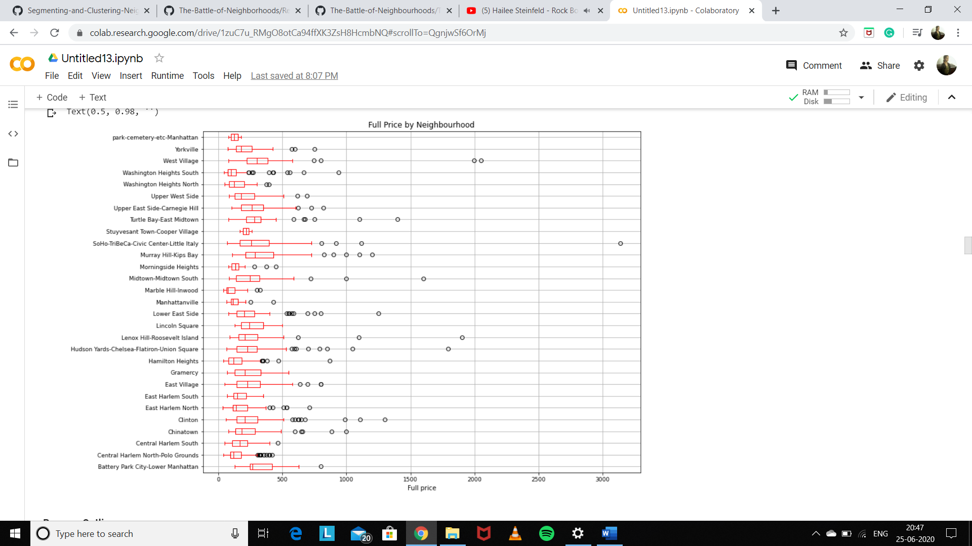
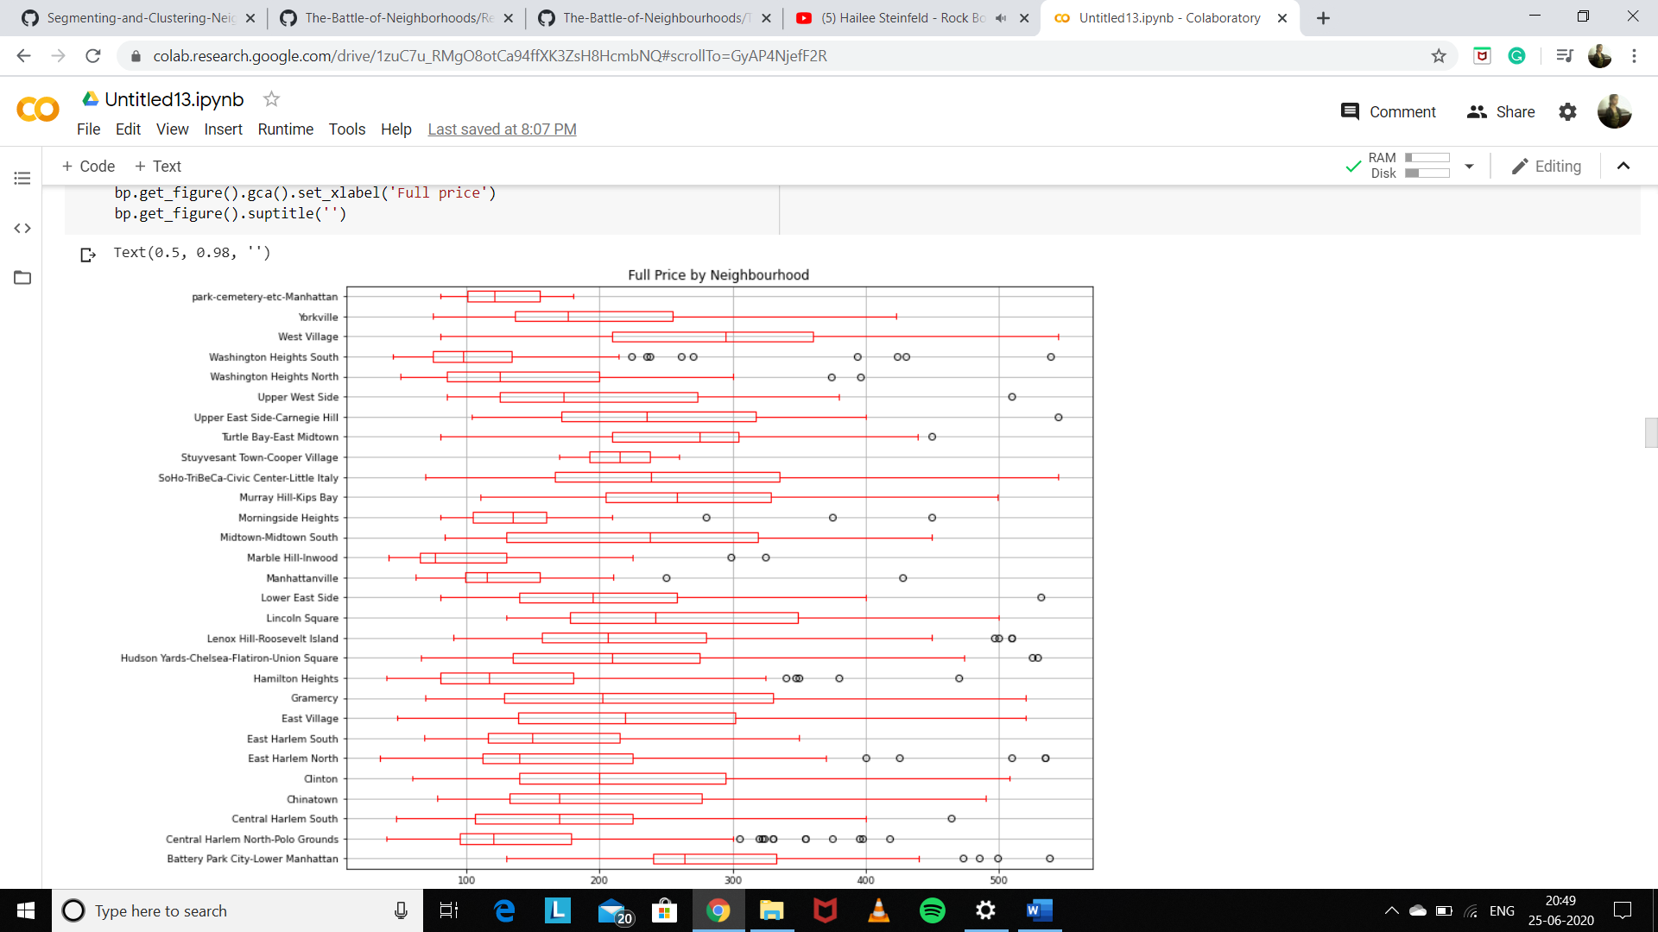
Outliners
In the chart on left we can see some outliers - observation points that are distant from other observations. In our case they are the indication of variance in the data. So we remove them.

Slide 12
3. Procedure
In the first step we collected the following data:
Airbnb Accommodations with their NYC Tabulation Area (official neighbourhood names)
Airbnb Accommodation's number of crimes nearby
Defined NYC Tabulation Area (official neighbourhood name) for each Manhattan's crime case.
The second step in our analysis will be a calculation and exploration different neighbourhoods of Manhattan. We will explore the following characteristics:
number of crimes in the area
average price per person
number of accommodations available.

Slide 13
In third step we select Top-100 Airbnb accommodations based on:
Summary rating, number of crimes and price per person
Invoke Foursquare API to find Top accommodations' nearby venues create

Slide 14
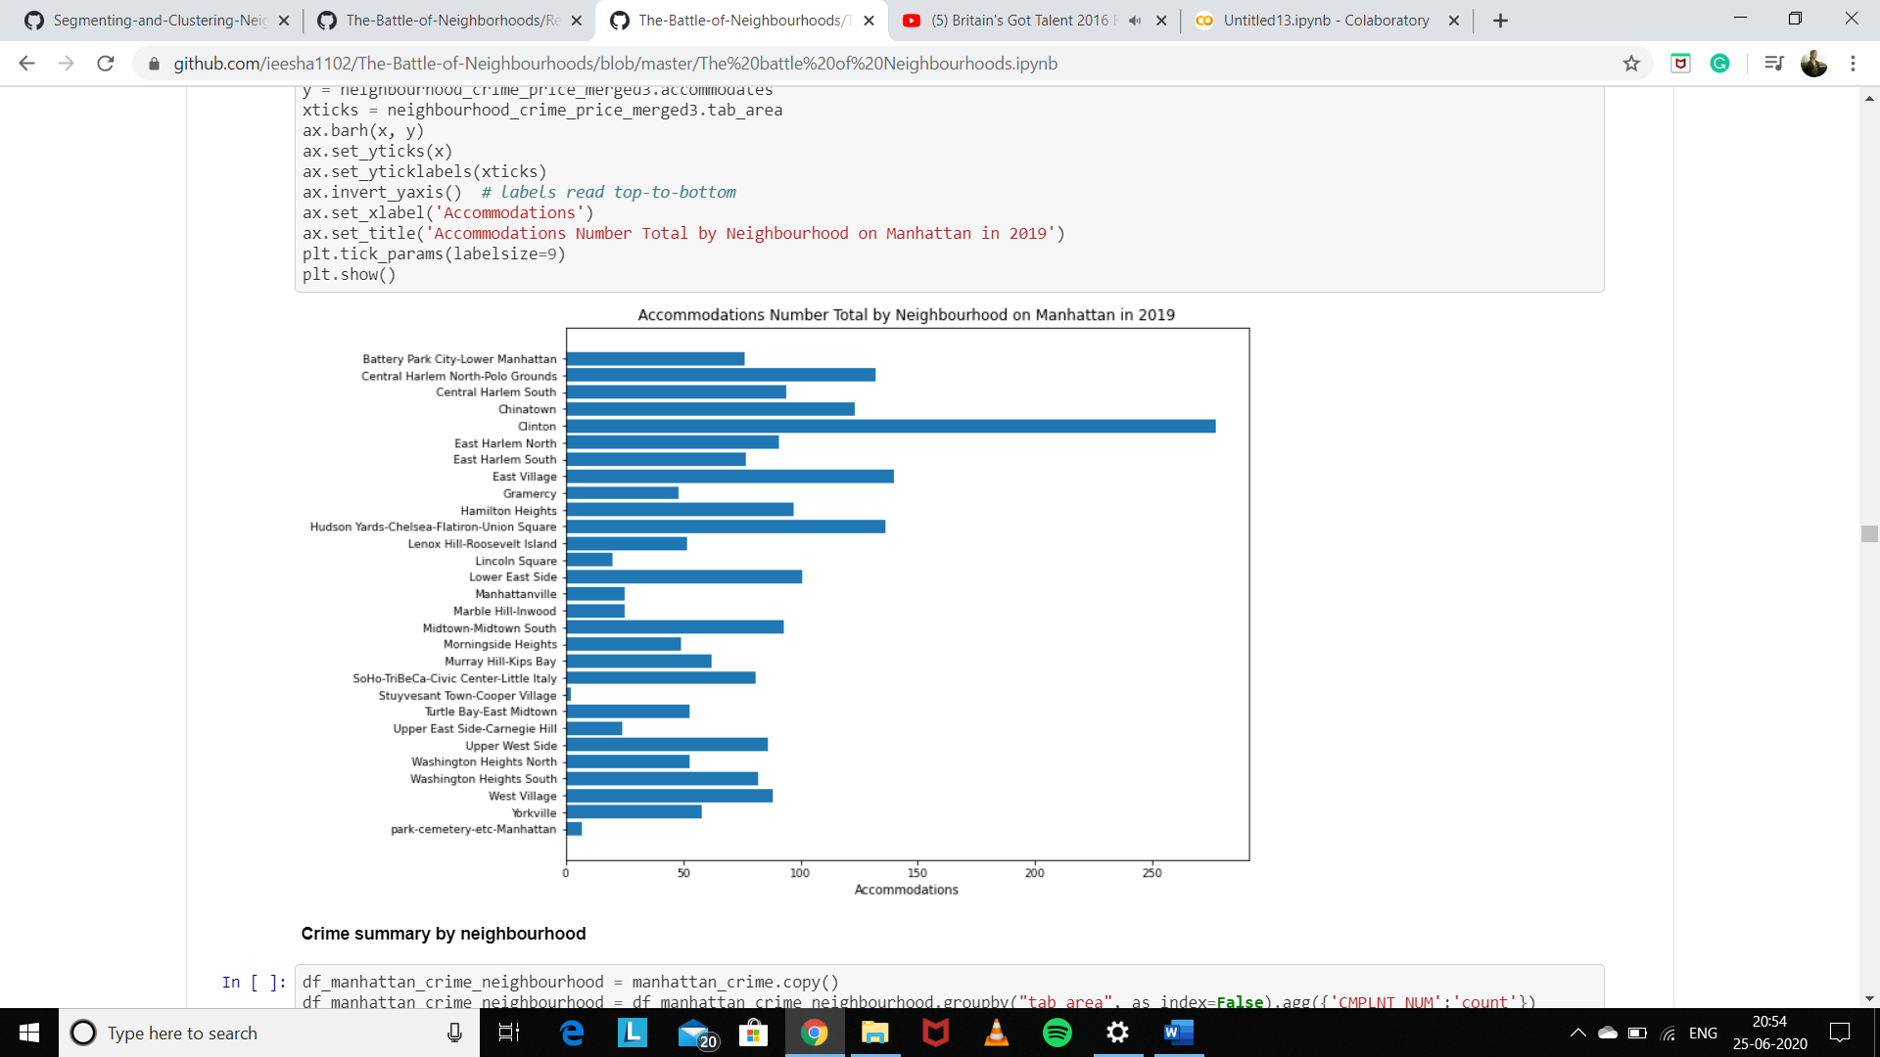
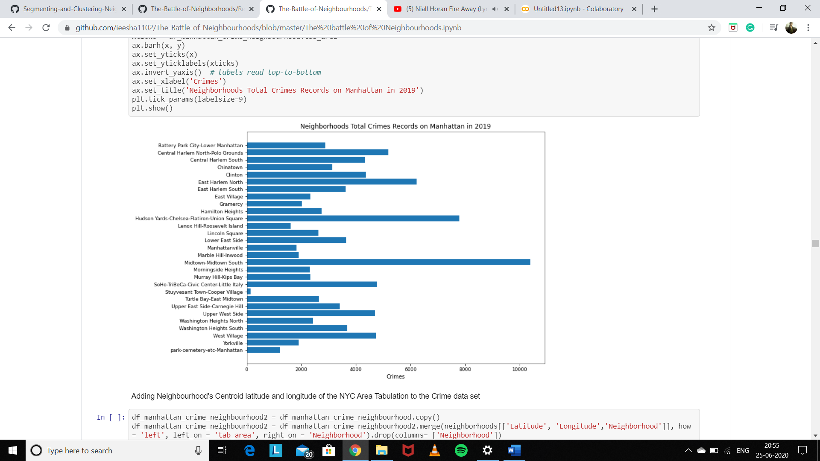
4. Analysis
Apartment Total by Neighbourhood
Neighbourhood Crime Records

Slide 15
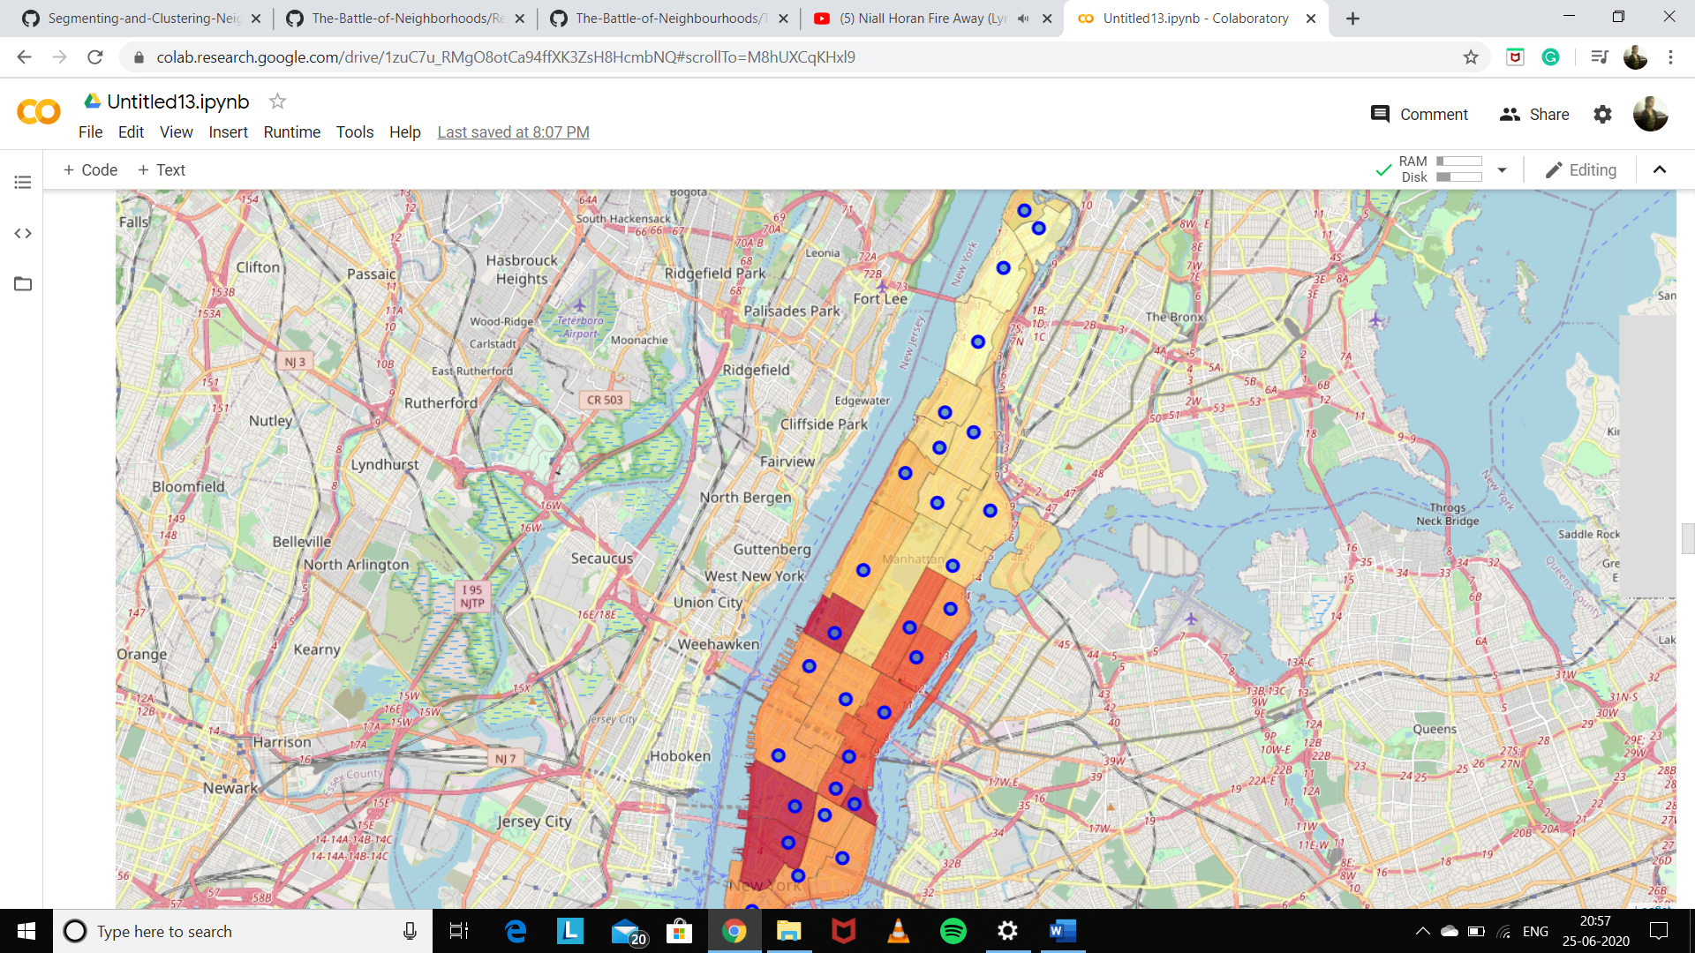
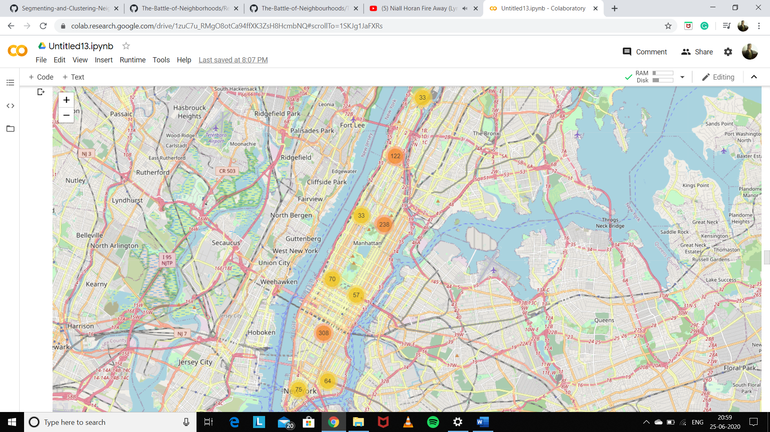
Analysis Map
Crimes Cluster Map

Slide 16
Top-5 Neighbourhoods with the Highest Crime level:
Midtown-Midtown South - 10,397
Hudson Yards-Chelsea-Flatiron-Union Square - 7,788
East Harlem North - 6,221
Central Harlem North-Polo Grounds - 5,186
SoHo-TriBeCa-Civic Center-Little Italy - 4,789
Top-5 Neighbourhoods with the Lowest Crime level in 2019 year :
Stuyvesant Town-Cooper Village - 145
park-cemetery-etc-Manhattan - 1,213
Lenox Hill-Roosevelt Island - 1,604
Manhattanville - 1,832
Yorkville - 1,898

Slide 17
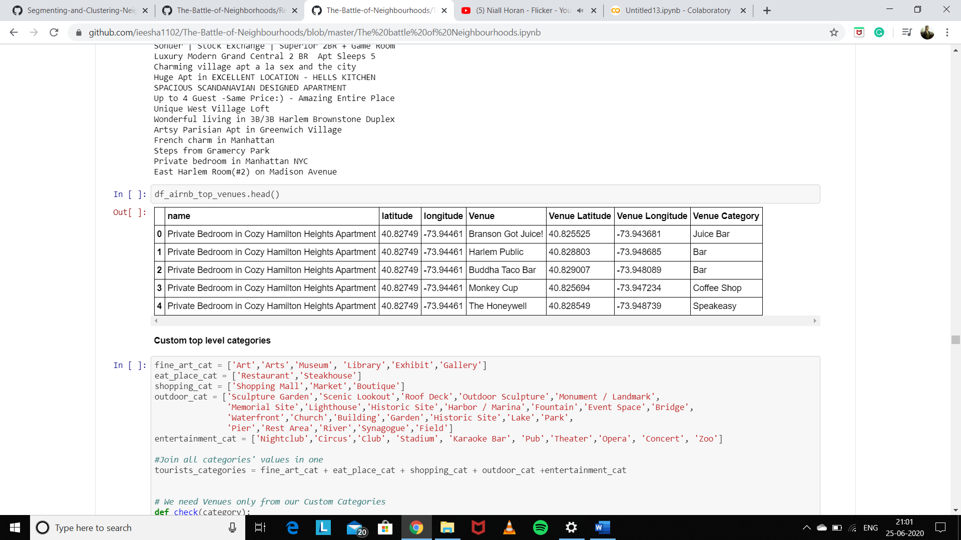
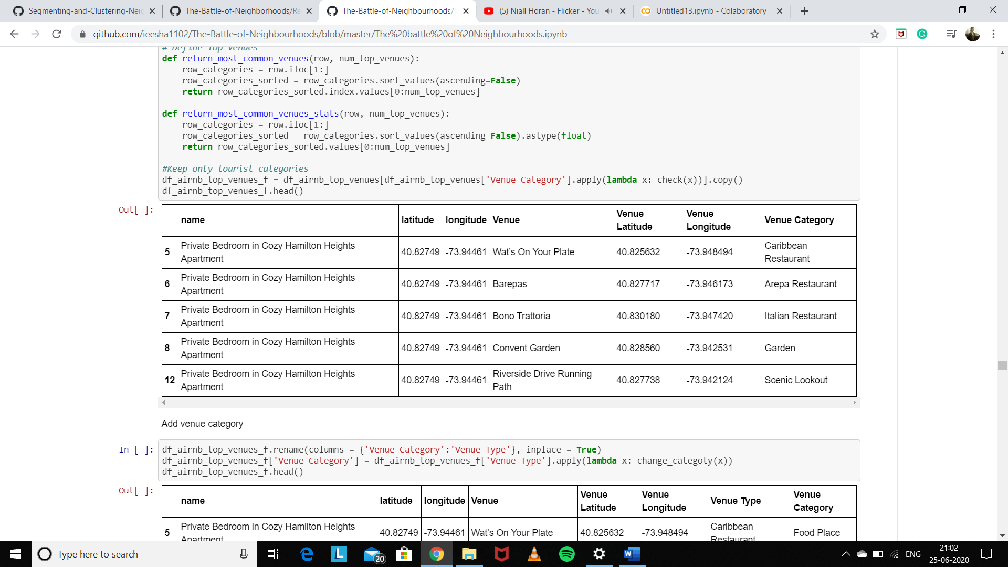
Foursquare API Neighbourhoods Analysis
We choose Top accommodations by
review_scores_rating - overall accommodations rating - from maximum 100 to lower values
full_price - from lower price to higher
price_per_person - from lower price to higher
crimes - from lower number to higher
Custom top level categories

Slide 18
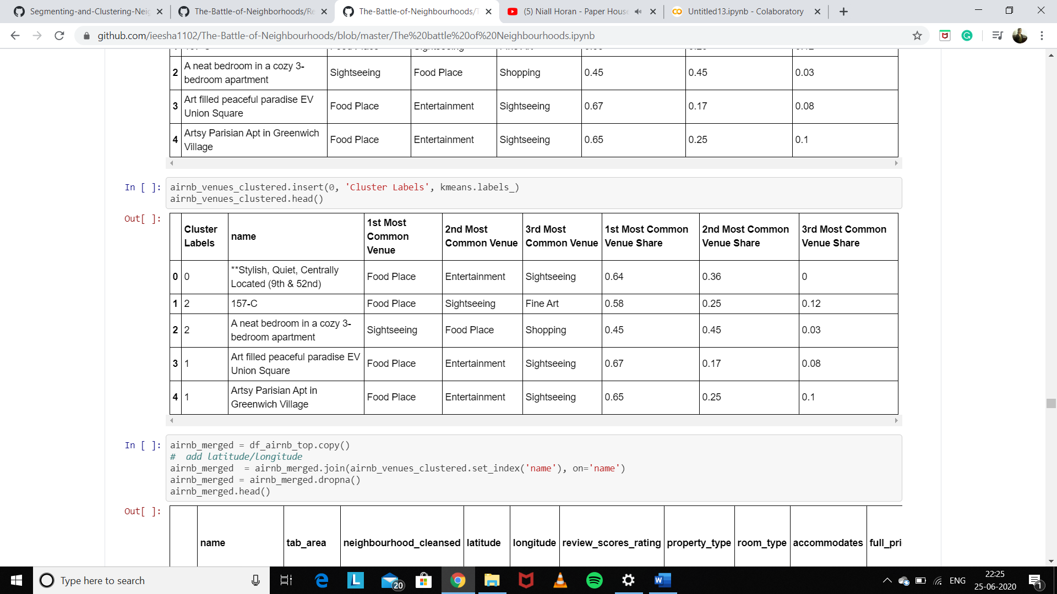
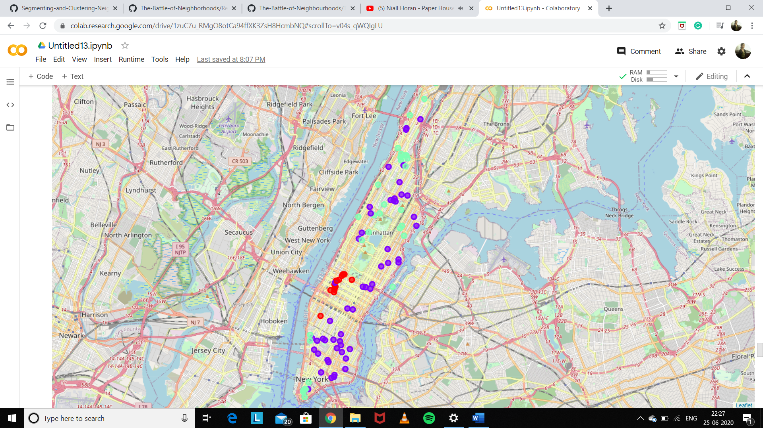
K-means Clustering

Slide 19
5. Result & discussion
The analysis defined 3 clusters All clusters have a 'Food Place' category as the first Common Venues. This is common among the clusters defines clusters. But they are distinguished by the other characteristics as
Average price per person
Average crimes Rate
The second common Venues
Number of available Airbnb accommodations
Neighbourhood location

Slide 20
Cluster 0 - This is the smallest cluster with the following particular qualities (Nightclub, Stadium, Pub, Theatre, Concert and so on):
highest average price_per_person among all clusters - $111
highest average crimes rate among all clusters - 102
is 1st and the 2nd Top Common Venue Categories
contains 15% from all top accommodations (Top-100 Airbnb accommodations)
spreads on Chelsea, Hell's Kitchen, and Midtown Airbnb's Neighbourhoods.
Cluster 1 : It contains
average price_per_person - $110
average crimes rate - 67
mix of all Venue Categories
contains 58% from all accommodations selected from analysis (Top-100 Airbnb accommodations)
spreads almost on all Manhattan's areas.

Slide 21
Cluster 2 Sightseeing is the cheapest one with many Sightseeing attractions nearby
lowest average price_per_person - $59
lowest crimes rate among all clusters - 65
Sightseeing is the second top Common Venue Category
contains 27% from all top accommodations (Top-100 Airbnb accommodations)
spreads on East Harlem, Financial District, Harlem, Inwood, Morningside Heights, Roosevelt Island, Upper West Side, Washington Heights, West Village.
We identified three clusters from which a visitor could choose an appropriate accommodation based on his/her preferences or needs.

Slide 22
Top Neighborhoods Statistics
Top-5 Manhattan Tab Area (Airbnb Neighborhoods) with Lowest Average Price per Person in 2019 year:
Marble Hill-Inwood (Marble Hill, Inwood)- 45.48 USD - 25 accommodations
Washington Heights South (Washington Heights)- 46.79 USD - 82 accommodations
Washington Heights North (Inwood, Washington Heights)- 54.74 USD - 53 accommodations
Central Harlem North-Polo Grounds (Harlem, East Harlem)- 57.00 USD - 132 accommodations
Manhattanville (Harlem)- 59.75 USD - 25 accommodations
Top-5 Manhattan Tab Area (Airbnb Neighborhoods) with the Lowest Crime level in 2019 year :
Stuyvesant Town-Cooper Village (Stuyvesant Town) -145
park-cemetery-etc-Manhattan (Inwood, Washington Heights) - 1,213
Lenox Hill-Roosevelt Island (Roosevelt Island, Upper East Side) - 1,604
Manhattanville (Harlem) - 1,832
Yorkville (Upper East Side) - 1,898

Slide 23
Note
Our analysis was limited to Manhattan Brugh's only
Foursquare developer account has a limitation of 950 calls/day so maybe it's worth to upgrade our free account to analyze Top-1000 Airbnb accommodations instead of Top-100.

Slide 24
6. Conclusion
The basic data analysis was performed to identify Manhattan's Neighborhoods clusters for a short stay visit. During the analysis, we cleaned and investigated Manhattan Neighborhoods' datasets, found some statistical characteristics and visualize them.
The aim of this project is to help Manhattan visitors select the Airbnb neighborhoods where to stay based on the most common venues, price policy, and safety characteristics:
If a person is interested in Entertainment (Nightlife, Pubs, Concerts, Movies) we recommend paying attention for accommodations from the Cluster 0 - * Entertainment: Chelsea, Hell's Kitchen, and Midtown Airbnb's Neighborhoods. But the person should take into the consideration the high prices and crime rate for this location
if a person is looking for a neighborhood with lower prices and nice views nearby we recommend looking at Cluster 2 - Sightseeing: Chelsea, Hell's Kitchen, and Midtown Airbnb's Neighborhoods
if a person does not have any preferences - investigate proposals from Cluster 1 - Mix. It has average prices and spreads over almost all Manhattan's neighborhoods.

Slide 25
Thank you
Author: Ieesha Deshmukh

